Slide 1
Data Summarization and Visualization
Dr. Alexander Victor

Slide 2

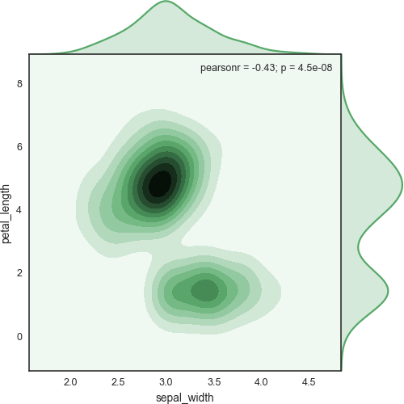
Overview
Data summarization
Summary statistics
Measures of central tendency
Measures of variation
Measures of correlation
Data visualization
Why visualization is important
Visualizing distributions
Visualizing relationships
Comparing quantities
Visualizing composition
Designing visualizations
Non-statistical visualizations

Slide 3
Data summarization

Slide 4
Overview
Data distributions
Measures of centrality
Mean, median, mode
Sample mean vs population mean
Measures of variation
Variance, standard deviation
Range and Interquartile range
Sufficient statistics
Skewness and kurtosis Conditioning on attributes Measures of association
Pearson
Spearman

Slide 5
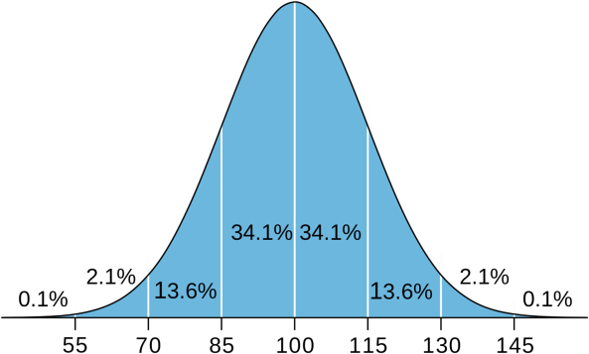
Distributions
p(IQ = x)
The data distribution describes the probability of a random variable taking a particular value.
Example: IQ follows a Normal (Gaussian) distribution. ~70% of people have an IQ between 85 and 115, 95% between 70 and 130.
A random number generator (np.random.rand) will generate random numbers that follow a uniform distribution in [0, 1]
A roll of a biased dice has a categorical distribution (multinomial) over the values {1, 2, 3, 4, 5, 6}
0
1
1
2
3
4
5
6

Slide 6
Measures of central tendency
A sample statistic is a measurement on a sample from a distribution, calculated by applying a function to the sample.
Measures of central tendency are sample statistics that attempt to capture where the middle of a distribution is.
p(x)
Many ways of measuring central tendency.
Three common ones:
Mean
Median
Mode
x

Slide 7

Mean, median, mode
Arithmetic mean: sum of observations divided
by number of observations
The median is a robust statistic (less sensitive
to outliers)
Mode: the most frequent value in the dataset. Suitable measure of central tendency for nominal variables.
Easy to compute for discrete values: most frequent value.
Not straightforward for continuous distributions
(some have no well-defined mode).
Median: the middle value that separates the higher half from the lower half of the data set
Sort data and take middle value.
Even number of observations: take arithmetic mean of middle two values

Slide 8
Mean, median, mode
1, 2, 2, 3, 4, 7, 9
Mean
Median
Mode
(1 + 2 + 2 + 3 + 4 + 7 +
9) / 7
= 4
1, 2, 2, 3, 4, 7, 9
= 3
1, 2, 2, 3, 4, 7, 9
= 2

Slide 9
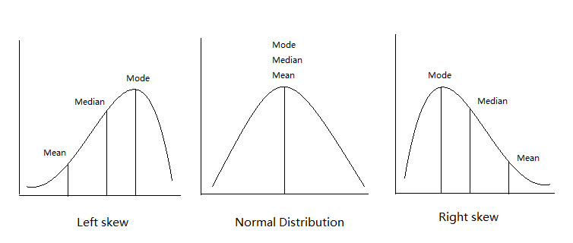
Mean, median, mode
 | Dimension | Type | Calculate
Mean | N | Quantitative | np.mean
Median | 1 | Ordinal | np.median
Mode | N | Nominal | From histogram

Slide 10
Sample mean vs population mean
The population mean is the true mean for the
entire population.
𝜇
The sample mean (average) is the calculated
mean of a sample from a population.
𝑥ҧ
E.g. the population mean human height would require measuring the height of every person on earth. A sample mean 100 randomly chosen people.
As sample size increases the sample mean
approaches the population mean.
lim 𝑥_{𝑛}ҧ = 𝜇
𝑛→∞

Slide 11
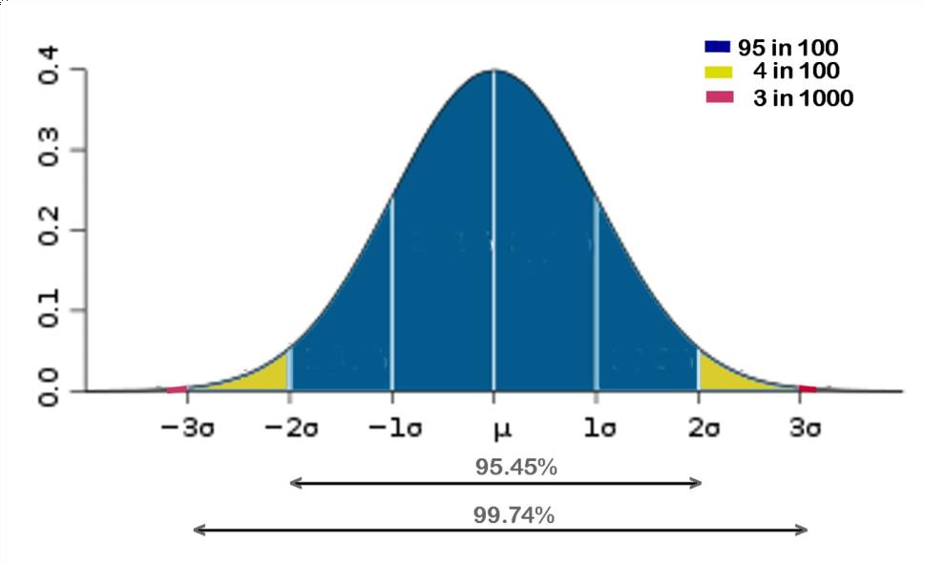
Measures of statistical dispersion
Measures of how stretched or squeezed a
distribution is.
Normal PDF
Most common methods are:
Variance (𝜎²)
Standard deviation (𝜎)
Interquartile range (IQR)
Again, can be defined for sample or population.

Slide 12
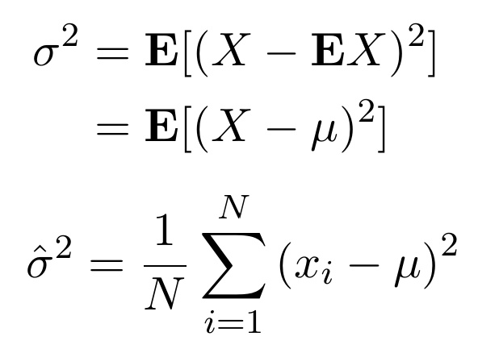
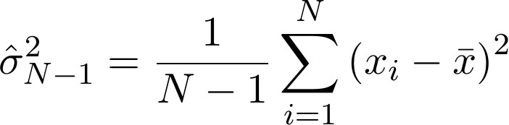
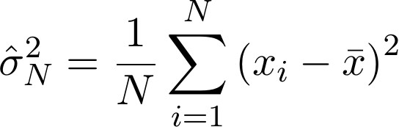
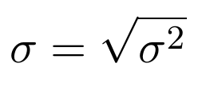
Variance, SD
Variance: the expected squared deviation from
the mean.
For small samples, this is biased, so may want
to use the bias corrected estimator:
The above is known as Bessel's correction.
The standard deviation is just the square root of the (possibly bias corrected) variance.
Usually we don’t know the population mean 𝜇, so we just use the sample mean:

Slide 13
Range and interquartile range
The range of a sample is the difference
between its minimum and maximum values.
i | x_{i} | Quartile
1 | 7
2 | 7
3 | 21
4 | 31 | Q₁ (25% percentile)
5 | 47
6 | 75
7 | 87 | Q₂ (median)
8 | 115
9 | 116
10 | 119 | Q₃ (75% percentile)
11 | 119
12 | 155
13 | 177
25%
The range is not a robust statistic!
The IQR is the range in which 50% of the data
lies.
IQR = Q₃ − Q₁ = 119 − 31 = 88
q1, q3 = np.percentile(x, [75 ,25]) iqr = q1 - q3
Pandas: DataFrame.quantile()
IQR
25%

Slide 14
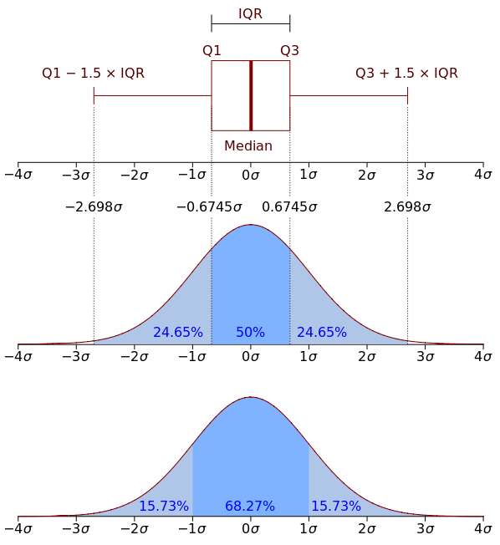
Interquartile range
IQM can be used on ordinal variables and often
makes more sense than the standard deviation.

Slide 15
Sufficient statistics
In statistics, a statistic is sufficient with respect to a statistical model and its associated unknown parameter when no other statistic that can be calculated from the same sample provides any additional information as to the value of the parameter.
Once you know the sufficient statistics, you know everything there is to know about the distribution of a variable.
For the Normal distribution, sufficient statistics are the mean and standard deviation.
𝜃 = {𝜇, 𝜎}

Slide 16
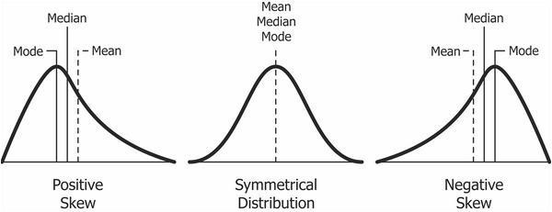
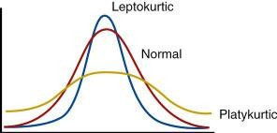
Skewness and kurtosis
Most data are not normally distributed.
Skewness is a measure of the asymmetry of the probability distribution of a real-valued random variable about its mean.
Kurtosis is a measure of how heavy the tails are of a probability distribution of a real-valued random variable.

Slide 17


Skewness and kurtosis
Pearson's moment coefficient of skewness
Third standardized moment:
Pearson's moment coefficient of kurtosis
Fourth standardized moment:
Replace mu and sigma with sample statistics to calculate for a sample
scipy.stats.skew(x)
scipy.stats.kurtosis(x)

Slide 18
Pandas describe
import seaborn as sns
tips.describe()
tips = sns.load_dataset("tips") tips.head()
 | total_bill | tip | size
count | 244.000000 | 244.000000 | 244.000000
mean | 19.785943 | 2.998279 | 2.569672
std | 8.902412 | 1.383638 | 0.951100
min | 3.070000 | 1.000000 | 1.000000
25% | 13.347500 | 2.000000 | 2.000000
50% | 17.795000 | 2.900000 | 2.000000
75% | 24.127500 | 3.562500 | 3.000000
max | 50.810000 | 10.000000 | 6.000000
 | total_bill | tip | sex | smoker | day | time | size
0 | 16.99 | 1.01 | Female | No | Sun | Dinner | 2
1 | 10.34 | 1.66 | Male | No | Sun | Dinner | 3
2 | 21.01 | 3.50 | Male | No | Sun | Dinner | 3
3 | 23.68 | 3.31 | Male | No | Sun | Dinner | 2
4 | 24.59 | 3.61 | Female | No | Sun | Dinner | 4

Slide 19
Conditioning on categorical variables
 |  | size | tip | total_bill
Lunch | count | 68.000000 | 68.000000 | 68.000000
 | mean | 2.411765 | 2.728088 | 17.168676
 | std | 1.040024 | 1.205345 | 7.713882
 | min | 1.000000 | 1.250000 | 7.510000
 | 25% | 2.000000 | 2.000000 | 12.235000
 | 50% | 2.000000 | 2.250000 | 15.965000
 | 75% | 2.000000 | 3.287500 | 19.532500
 | max | 6.000000 | 6.700000 | 43.110000
Dinner | count | 176.000000 | 176.000000 | 176.000000
 | mean | 2.630682 | 3.102670 | 20.797159
 | std | 0.910241 | 1.436243 | 9.142029
 | min | 1.000000 | 1.000000 | 3.070000
 | 25% | 2.000000 | 2.000000 | 14.437500
 | 50% | 2.000000 | 3.000000 | 18.390000
 | 75% | 3.000000 | 3.687500 | 25.282500
 | max | 6.000000 | 10.000000 | 50.810000
Compute statistics based on subsets of the sample.
Subsets selected by grouping on categorical
variables.
These are statistics on the conditional distributions. E.g. P(size | time = Lunch)
Pandas: tips.groupby('time').describe() tips.groupby('smoker').mean()

Slide 20
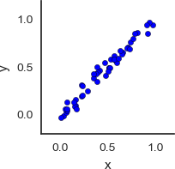
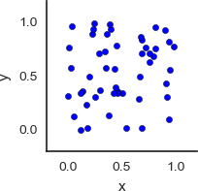
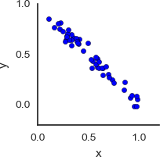
Statistics of association between attributes
Covariance: measures how much two variables vary together.
Large positive cov
Near zero cov
Large negative cov

Slide 21

Statistics of association between attributes
Pearson product-moment correlation coefficient (Pearson's rho): measure of the linear relationship
between quantitative variables. Normalized version of the covariance:
rho = -1
Ranges from -1 to 1.
> 0: positive correlation
< 0: negative correlation
● +1 indicates a perfect linear relationship between X and Y
-1 is perfect negative correlation
Not suitable for ordinal variables!

Slide 22
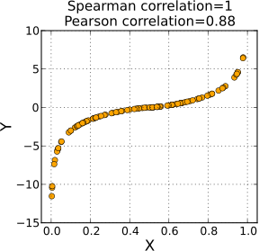
Spearman correlation
Spearman's rank correlation coefficient (Spearman's rho): the Pearson correlation between the rank values of those two variables.
Pearson's correlation assesses linear relationships, Spearman's correlation assesses monotonic relationships (whether linear or not).

Slide 23
Computing measures of association
Covariance
Numpy (covariance matrix)
np.cov(x, y)
Spearman
Scipy
scipy.stats.spearmanr(a, b)
Pandas
df.corr(method='spearman')
Pearson
Scipy
scipy.stats.pearsonr(x, y)
Pandas
df.corr(method='pearson')

Slide 24
On correlation vs causation
Correlation does NOT imply causality!
A correlates with B
could mean…
A causes B
B causes A
C causes both A and B

Slide 25
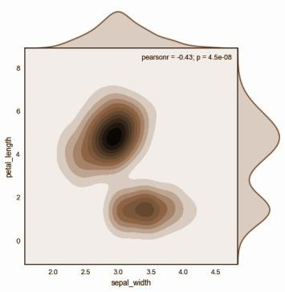
Data visualization

Slide 26
Why visualize data?
Explore
Understand data and relationships between attributes
Generate new hypotheses
Detect errors and anomalies
Confirm
Hypotheses already generated
Check assumptions
Verify conclusions
Communicate
Analysis has been completed
Conclusions verified
Task: Present and communicate results
Inform, persuade, educate, entertain

Slide 27
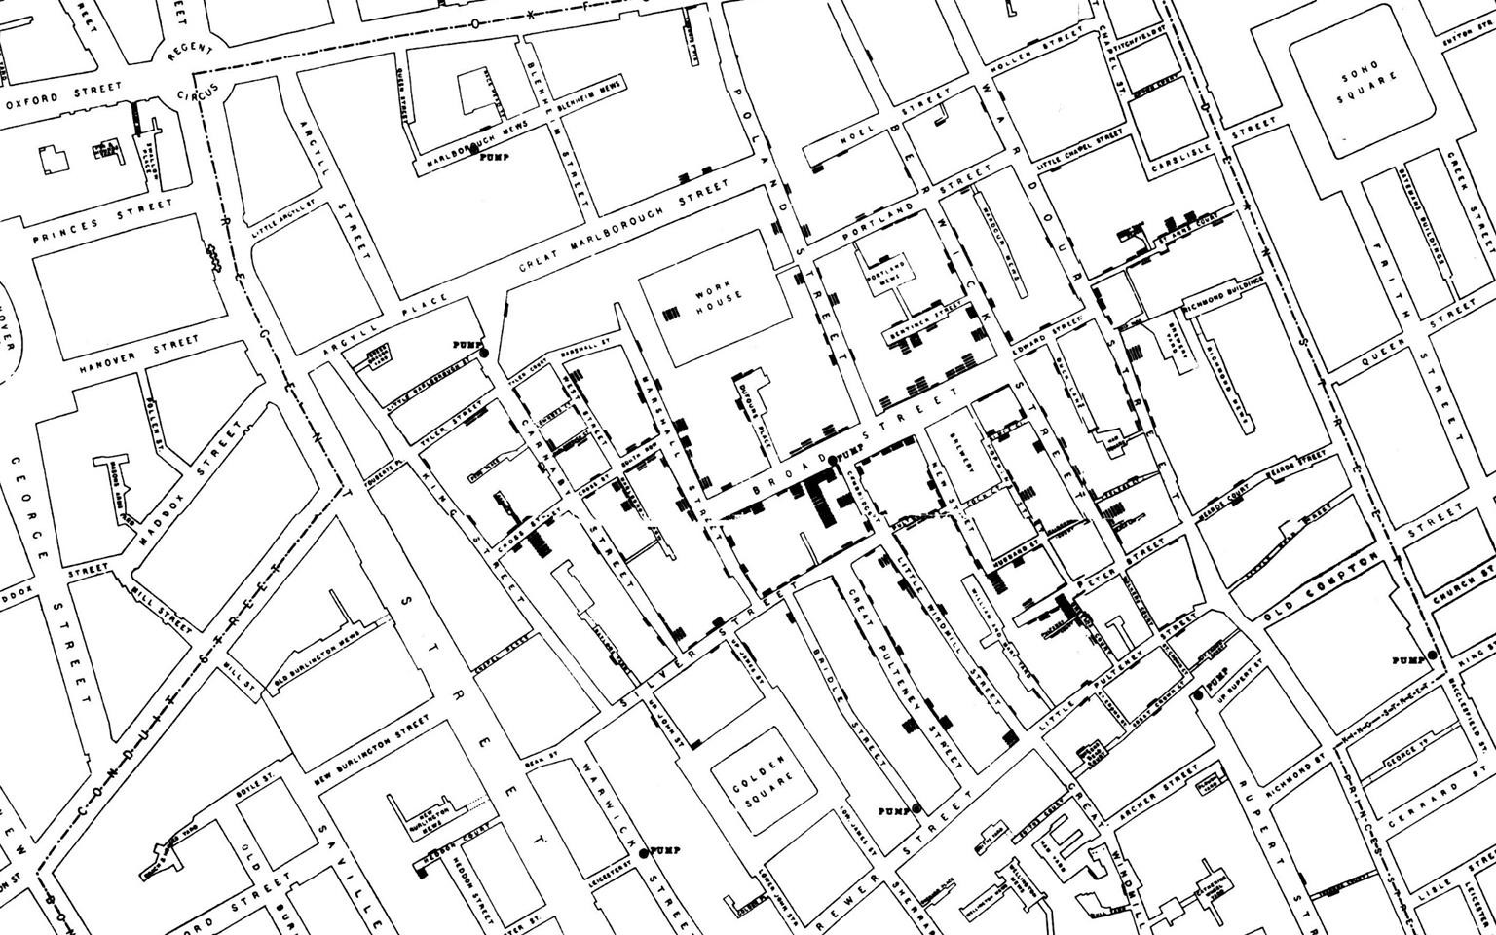
Explore:
John Snow's visualization of the London cholera outbreak of 1854

Slide 28
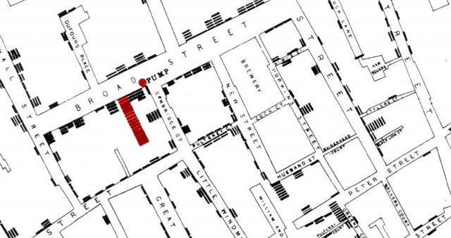
Explore:
John Snow's visualization of the London cholera outbreak of 1854

Slide 29
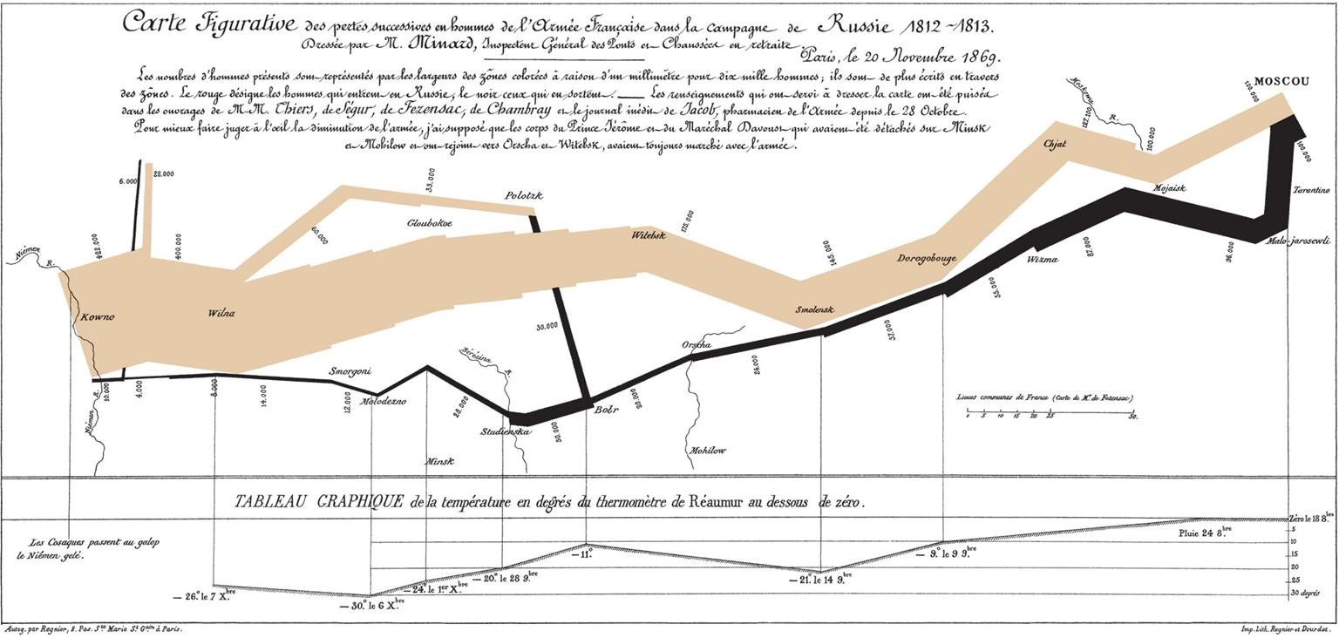
Present and communicate:
Charles Minard's map of Napoleon's disastrous Russian campaign of 1812.

Slide 30
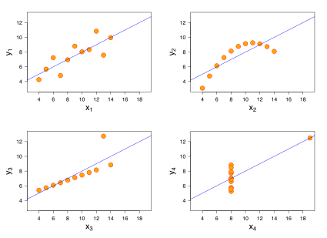
Importance of visualization: Anscombe's quartet
Linear +
Gaussian Noise
Nonlinear
relationship
Linear + outlier
No relationship
+ outlier

Slide 31
Importance of visualization: Anscombe's quartet
Mean of x in each case | 9
Sample variance of x in each case | 11
Mean of y in each case | 7.50
Sample variance of y in each case | 4.122 - 4.127
Correlation between x and y in each case | 0.816
Linear regression line in each case | y = 3.00 + 0.500x

Slide 32
Statistical data visualization
Visualizations like the ones just shown are extremely informative, but it take significant time to conceptualize and create.
There are many “off the shelf” visualizations that we can use for routine exploratory and visualization work.
Statistical graphics are used to explore the statistical properties of data in a visual way
Statistical data visualizations provide a set of
standard visual tools for:
Understanding the shape and distribution of data
Understanding the relationships between
attributes
Understanding composition and part- whole relationships
Comparing quantities

Slide 33
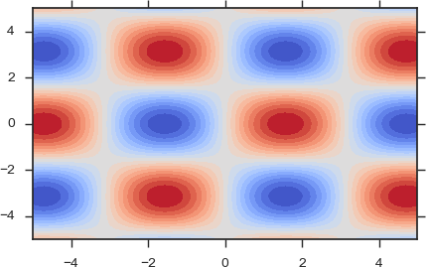
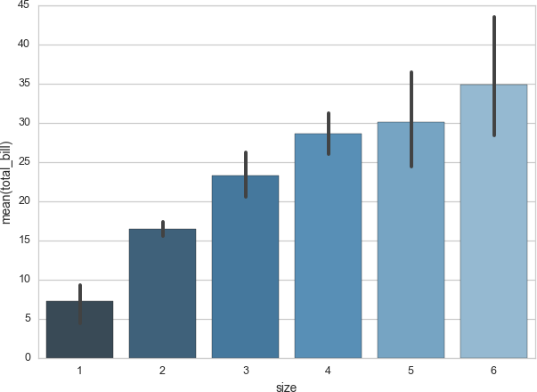
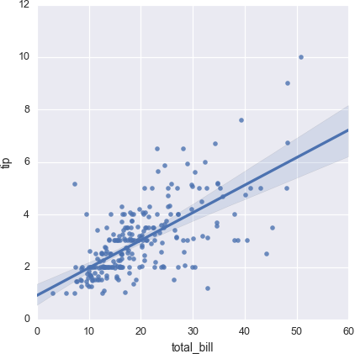
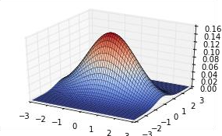
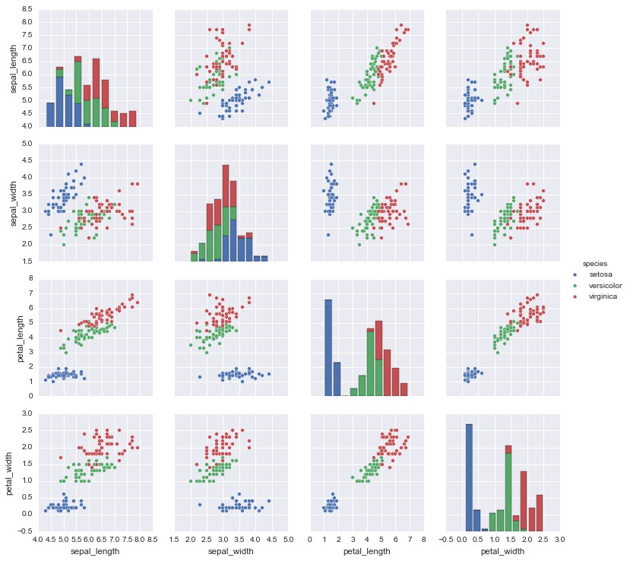
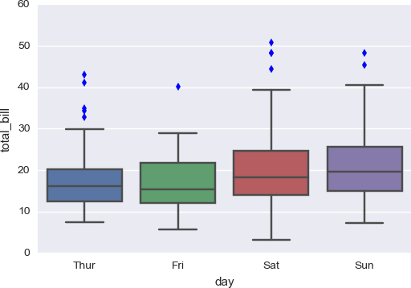
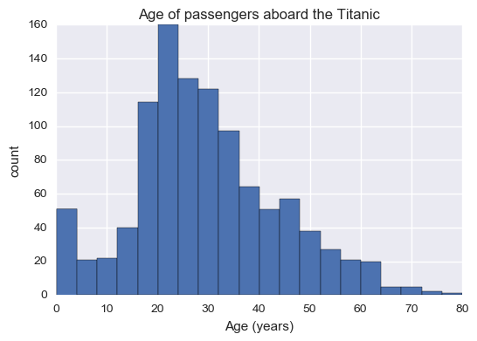

Slide 34


Software packages for visualization
Python
Matplotlib: 2D plotting library with simple MATLAB style API
Seaborn: Built on Matplotlib and provides a high-level
interface for drawing attractive statistical graphics
Bokeh: interactive visualization library that targets modern web browsers
Others
ggplot2 (R language)
d3js (Javascript)
Processing (Java)

Slide 35
Topics
Visualizing the shape and distribution of data
Visualizing relationships between attributes
Comparing quantities
Visualizing composition and part-whole relationships
Design principles and visualization faux pas

Slide 36
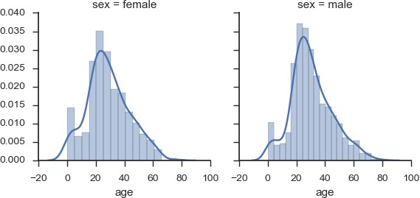
Visualizing the data distribution
Data distribution: where are the areas in which
most of the data lives.
Shape
Is a variable normally distributed?
Is it multi-modal?
Are their long tails? Fat tails?
Is there distribution skewed?
Comparison
Modes
Are two distributions the same? Different?
Does conditioning on a variable affect the distribution?
Where are the modes of the distribution?
Which values occur most frequently?
Outliers: are there obvious outliers that need to
be removed/imputed?

Slide 37
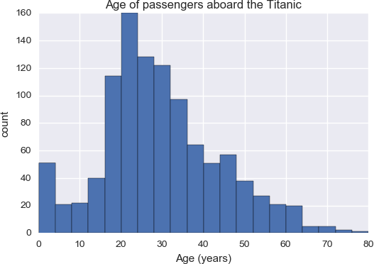
Histograms
A histogram is a graphical representation of the
distribution of numerical data.
Histograms allow you to look at the shape of the distribution of a single quantitative variable
Construction: divide the range of values into intervals (bins) and count how many values fall in each bin
Matplotlib:
ages = df['age'].dropna()
hist(ages, bins=20)
xlabel('Age (years)'); ylabel('count') title('Age of passengers aboard the Titanic')

Slide 38
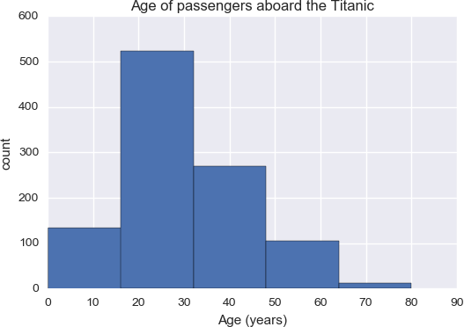
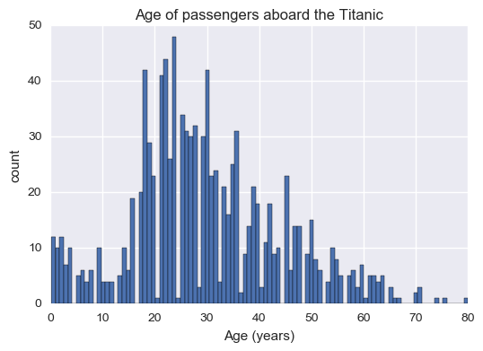
Histograms
5 bins
Uses:
Get an idea for the shape of a distribution
Determine if attribute is unimodal or multimodal
See maximums and minimums
Spot outliers
Choosing the right number of bins is important!
Too few fails to capture details in shape
Too many: lots of empty bins
100 bins
Usually bins are of fixed width, but not necessarily.

Slide 39
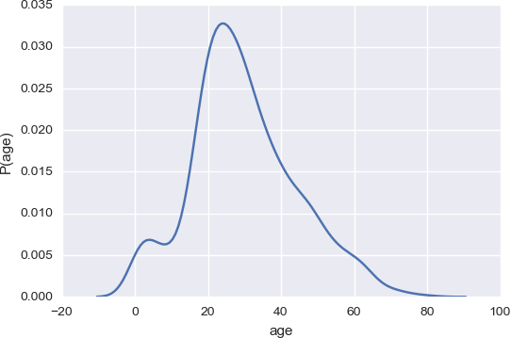

Kernel density estimators
Basic idea: estimate the probability density at a
point by counting points in local neighbourhood
K(.) is a kernel function, h is a bandwidth parameter. K function is smaller for large values and integrates to 1.
Seaborn
sns.distplot(ages, hist=False) xlabel('age'); ylabel('P(age)')

Slide 40
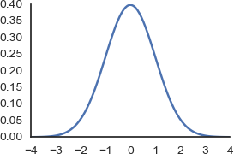

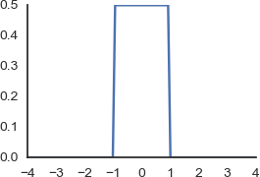

Kernel density estimators
Gaussian kernel:
Produces smooth density plots
Uniform kernel:
Produces histograms!

Slide 41
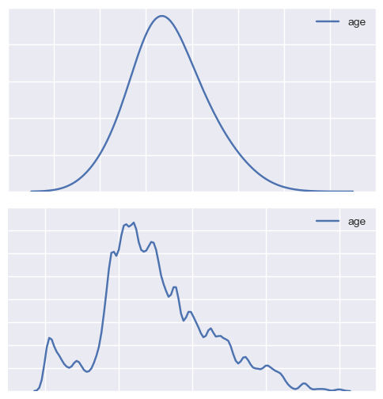
Kernel density estimators
Histograms: important to choose number of
bins appropriately
h = 10
Density plots: important to choose bandwidth
(h) properly
Too large: over smoothing
Too small: not enough smoothing
sns.kdeplot(ages, bw=10) sns.kdeplot(ages, bw=0.1)
h = 0.1

Slide 42
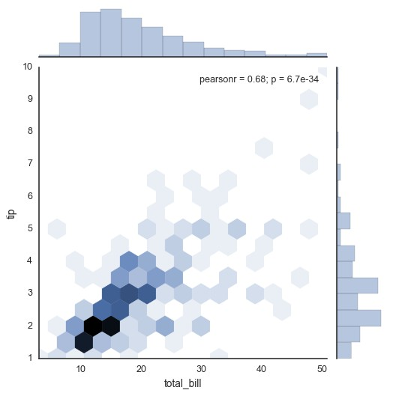
Joint distributions
Histogram of marginal distribution P(total_bill)
Standard histograms and density plots are fine
for plotting distribution of single variable.
What if we want to visualize the joint distribution of two variables P(x, y)
Hex plots are 2D analogies to histograms.
tips = sns.load_dataset("tips") sns.jointplot(
"total_bill", "tip",
data=tips, kind="hex")

Slide 43
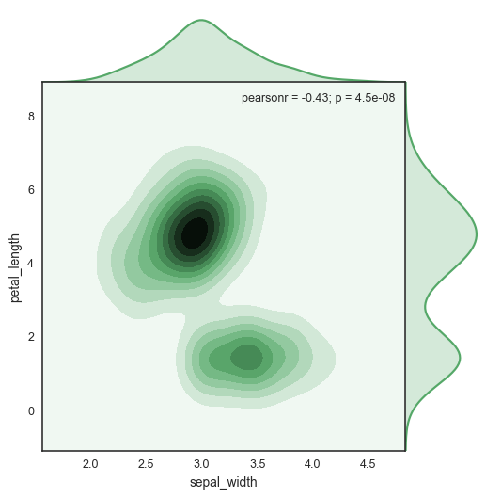
Joint distributions
KDE estimate of marginal distribution P(sepal_width)
Kernel density estimators also possible in 2D
iris = sns.load_dataset("iris")
sns.jointplot(
"sepal_width", "petal_length", data=iris, kind="kde", space=0, color="g")
This part is called a contour plot of P(x,y)

Slide 44
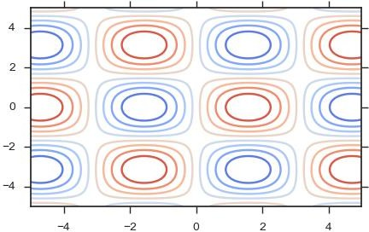

Contour plots
Incidentally, contour plots are not only for probability densities, but can be used to visualize any 2D function f(x, y) → R
E.g.
# create a grid of x, y values xs = linspace(-5, 5, 100)
ys = linspace(-5, 5, 100)
X, Y = meshgrid(xs, ys)
# define function and evaluate on grid f = lambda x, y: np.sin(x) * np.cos(y) Z = f(X, Y)
# plot filled contours
contourf(X, Y, Z, levels=linspace(-1, 1, 20), cmap=cm.coolwarm)

Slide 45
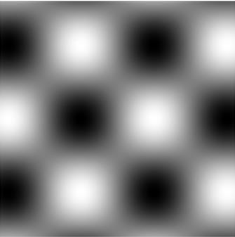
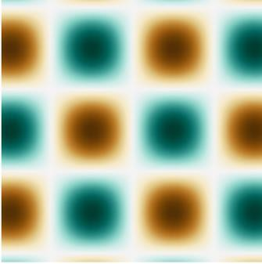
Using images to visualize functions of two variables
imshow(Z, cmap=cm.gray)
imshow(Z, cmap=cm.BrBG)
axis('off')
tight_layout()
axis('off')
tight_layout()

Slide 46
Boxplots
A boxplot (or box-and-whisker plot) shows the distribution of quantitative data in a way that facilitates comparisons between variables or across levels of a categorical variable.
The box shows the quartiles of the dataset
The whiskers extend to show the rest of the distribution, except for points that are determined to be outliers
The median is shown in the center of the box.

Slide 47
Boxplots
Especially useful for
detecting outliers
comparing distributions conditioned on a categorical (nominal) variable.
tips = sns.load_dataset("tips")
sns.boxplot(
x="day", y="total_bill", data=tips)

Slide 48
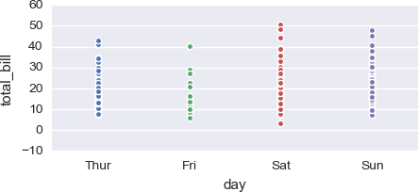
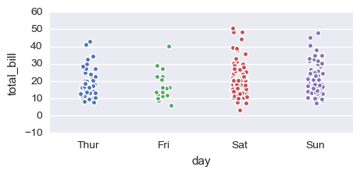
Strip plots and jitter plots
It is often good to plot the raw data points to ensure that you are not being mislead by factors like the kernel density estimator or skewed distributions.
Plotting the data points on a 1D line often results in overplotting.
One technique to alleviate overplotting is to add some noise to the x-coordinate. This is called jitter.
sns.stripplot(
x="day", y="total_bill",
data=tips, jitter=True)

Slide 49
Topics
Visualizing the shape and distribution of data
Visualizing relationships between attributes
Comparing quantities
Visualizing composition and part-whole relationships
Design principles and visualization faux pas

Slide 50
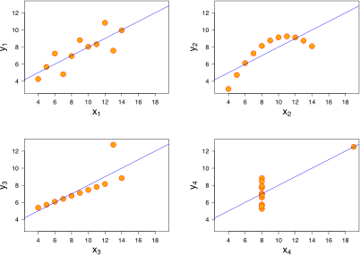
Visualizing relationships between variables
Pearson's and spearman's rho can be used to
numerically measure linear and rank correlation.
Visualization is an even more powerful way to examine the relationship between variables:
Non-linear relationships
Non-rank order relationships
Some statistical graphics:
Scatter plots
Regression plots
Line plots

Slide 51
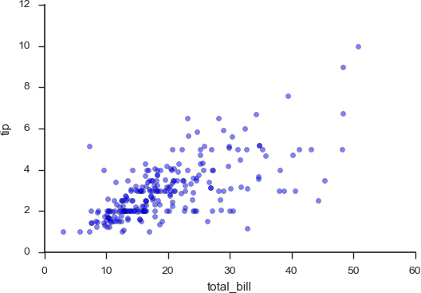
Scatter plots
Scatter plots (scattergrams) show the relationship between two variables by plotting the values of one variable against the other.
If variables are linearly correlated, they should appear to cluster around a diagonal line.
If variables are uncorrelated, or statistically independent, they will appear randomly scattered across the graph.
Non-linear relationships may also be apparent in
a scatterplot.

Slide 52
Scatter plots
Tip: using transparency helps reduce overplotting!
Generating scatter plots with matplotlib (and
seaborn for style):
sns.set_style('ticks')
scatter(
tips['total_bill'], tips['tip'], alpha=0.5)
xlabel('total_bill'); ylabel('tip')
# remove lines from box sns.despine()

Slide 53
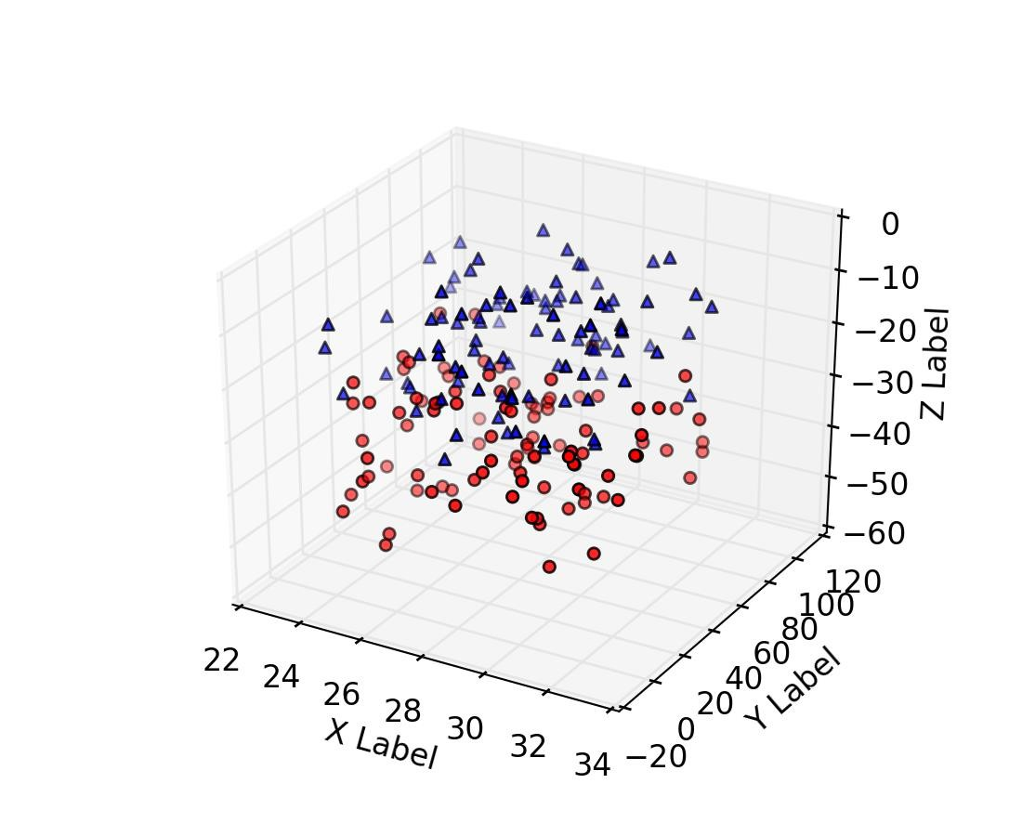
3D scatterplots
Usually not very useful.
Avoid.

Slide 54
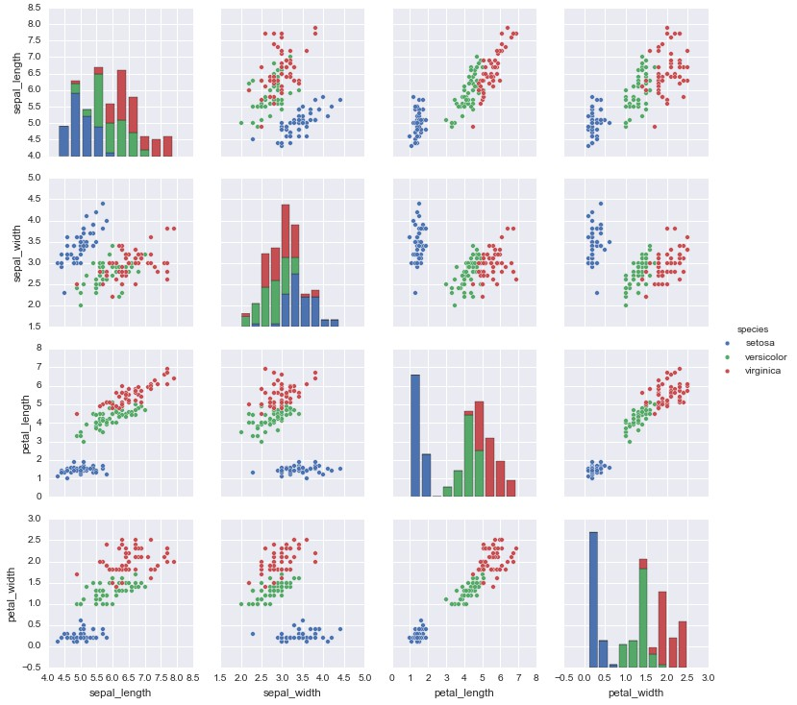
Scatterplot matrix
If you want to look at the relationships between several pairs of attributes simultaneously, you can use a scatterplot matrix.
The relationship between variable 1 and 2 is shown in (1, 2) in the matrix. It’s transpose is in (2, 1).
The correlation between any variable and itself is always 1. Plotting packages often use the diagonal of the scatterplot matrix to show additional info.

Slide 55
Seaborn shows univariate histograms of variables on the diagonal by default
Note use of color to indicate
nominal variable “species”
iris = sns.load_dataset('iris') sns.pairplot(
iris, hue='species')

Slide 56
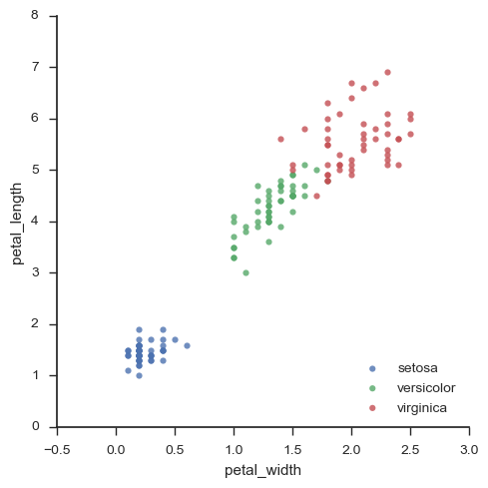
Notice anything strange about the data in this graph?
Values are quantized!
iris = sns.load_dataset('iris') sns.lmplot(
"petal_width", "petal_length", data=iris,
hue='species', fit_reg=False, legend=False) legend(loc='lower right')

Slide 57
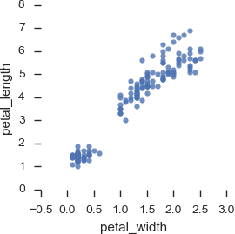
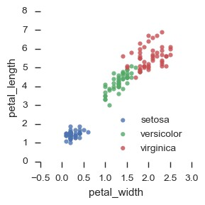
On the use of color
Color can be an incredibly useful tool for including more
dimensions in a 2D plot.
Tufte: color can be your greatest ally or worst enemy if used improperly
Example on right uses different colors to overlay the nominal
variable species on the scatter plot.
The choice of color palette used is important, and should reflect the type of variable being indicated and what you want to show.
Recall Stephen’s scales of measurement:
Nominal (categorical)
Ordinal (ordered)
Quantitative (ratio or interval)

Slide 58
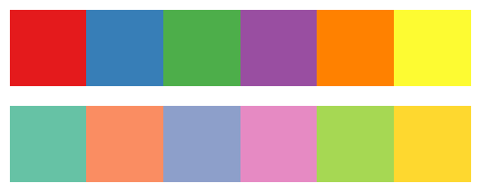


Choosing a color palette
Qualitative palettes
Do not imply an inherent ordering. Suitable for nominal variables. E.g. species,
gender, category, etc.
Sequential palettes
Imply an ordering. Appropriate when data range from relatively low or uninteresting values to relatively high or interesting values. Suitable for ordinal and quantitative variables. E.g. risk, crime rate
Diverging palettes
Also imply an ordering and suitable for ordinal and quantitative variables. Used for data where both large low and high values are interesting. Interpretable midpoint in the data. E.g. temperature, rainfall

Slide 59


Avoid “jet” and “rainbow”
Jet is (or was) the default color bar originally used by MATLAB.
Complex luminance profile tends to introduce artifacts that are not really there! Highlights features that may not exist.

Slide 60

Avoid “jet” and “rainbow”

Slide 61


Slide 62

Regression lines
When we think there is a linear relationship between two variables (x, y), we may want to plot a regression line to illustrate it.
To do this we can find the parameters (a, b) that
minimize the sum of squared errors:
y is the target variable (aka. dependant variable)
x is the predictor (feature, independent
variable)
a, b are parameters
epsilon is noise (assume iid Gaussian)
The parameters can be found using a little calculus and algebra. Compute deriv wrt. (a, b) and set to zero and solve linear system.
We’ll see how to do this in more detail when we
study supervised learning later...

Slide 63

Regression lines
Seaborn can be used to plot regression lines.
sns.regplot('total_bill', 'tip', data=tips)
By default, it will also plot confidence intervals
too (estimated using bootstrap)
The bootstrap is a non-parametric way of estimating confidence intervals.
Idea: sample data with replacement 100 times. Each time fit a regression line. Look at variation in fits

Slide 64


Axes scales
Sometimes data appears correlated, but not linearly. If y = exp(ax + b) + noise, then changing the axes
scale from linear to logarithmic allows a linear fit.
log(y)

Slide 65


Inappropriate uses of regression plots
random.seed(7) xs = rand(20) ys = rand(20)

Slide 66


Anscombe's quartet

Slide 67


Line graphs
Line graphs are appropriate for plotting one variable as a function of another continuous ordered variable.
Often x is time and y is some quantity we wish to study
over time. This is called a time series.
Data points are connected by lines. It’s good practice to include markers for the data points.
air = pd.read_csv('data/AirPassengers.csv') figure(figsize=(5,3))
plot(air.time, air.AirPassengers, marker='.') sns.despine()
xlabel('year')
ylabel('passengers')
title('Monthly Airline Passenger Numbers')

Slide 68

Facet grids (lattice plots)
Visualize multivariate relationships by displaying relationship between one or two variables conditioned on other nominal variables.
I.e. group data by facets (nominal variables) and plot groups on a grid.
If variable being conditioned upon is not
nominal, it can be quantized into intervals.
count
g = sns.FacetGrid(
tips, col="time", row="smoker")
g.map(plt.hist, "total_bill", bins=bins)

Slide 69
Topics
Visualizing the shape and distribution of data
Visualizing relationships between attributes
Comparing quantities
Visualizing composition and part-whole relationships
Design principles and visualization faux pas

Slide 70
Comparing quantities
Compare quantities conditioned on another
variable
Typical quantities:
Mean
Variance
E.g. accuracy given algorithm, height given gender, etc.
Time series: quantity given time.

Slide 71

Bar charts
Chicken Weights by Feed Type
Use for comparing quantities conditioned on a
categorical variable.
When quantities represent averages, confidence intervals can be also be plotted.
Seaborn uses bootstrapping to estimate
confidence intervals.
Bars be plotted horizontally or vertically. Horizontal bars better when there are many categories.
sns.barplot('feed', 'weight', data=chicken)

Slide 72

Bars chart tips
If it makes sense to interpolate between the bars (quantitative
variables), use a line chart. If not, use a bar chart.
Since categorical variables have no inherent order, sort
categories by bar height.
When there are only a few variables and confidence intervals don’t
matter, prefer a small table to a bar chart.
When conditioning on another variable, color can be used and bars can be grouped

Slide 73


Dot/point plots
Similar use to bar charts. Save ink!
More appropriate when there is no meaningful zero (interval measurements)
Can include a line when it makes sense to interpolate between values on x-axis.
sns.pointplot( 'size', 'tip',
data=tips, order=range(1,6))

Slide 74
Topics
Visualizing the shape and distribution of data
Visualizing relationships between attributes
Comparing quantities
Visualizing composition and part-whole relationships
Design principles and visualization faux pas

Slide 75
Visualizing composition
Visualizing composition of some "whole" as a set of parts.
Very often percentages.
Several widely used types of plots, but often it's better just to use a bar
plot!

Slide 76


Pie charts
A pie chart is a statistical graphic that illustrates numerical proportion using the arc lengths of the slices.
Widely used in business world and mass media.
Disadvantages:
Can only show small number of values
Take up more space than bar charts
Humans are poor at comparing arc
lengths and slice areas
Prefer a sorted bar charts to pie charts!

Slide 77


Avoid pie charts

Slide 78

Avoid pie charts

Slide 79

What about donuts?
Look cooler, but have the same problems as pie
charts. Avoid.
Prefer bar charts to pies and donuts!

Slide 80


Stacked area charts
Useful for displaying composition conditioned on time (time series composition)
sns.set_style('white')
# trick to get the legend to work colors = sns.color_palette(
"Paired", len(fields))
for field, color in zip(fields, colors):
plot([], [], label=field, color=color)
stackplot(range(10), data, colors=colors)
legend()
title('US foreign exchange reserves') xticks(range(10), currency.index[1:]) ylabel('USD $')
sns.despine()

Slide 81

Stacked area charts
To display percentages, simply convert
the absolute values to percentages
percent = data / data.sum(axis=0) * 100
Which version is best to use depends on
what you are trying to show.
Percentages show less information but highlight changes in composition.

Slide 82
Summary of visualizing composition
Studies show human beings are not very good at judging areas. In most cases, just use a bar or line chart to show composition!
✗
✓

Slide 83
Topics
Visualizing the shape and distribution of data
Visualizing relationships between attributes
Comparing quantities
Visualizing composition and part-whole relationships
Design principles and visualization faux pas

Slide 84
Faux pas
Chicken Weights by Feed Type

Slide 85
Faux pas
Forgetting to label the axes (when it’s important)
Chicken Weights by Feed Type

Slide 86

Faux pas

Slide 87
Faux pas
What’ does
this mean?
Line plot where bar is
more appropriate

Slide 88

Faux pas
Pie charts with too
many sectors
2-4 sectors max, only when differences are large.
Or avoid
altogether!

Slide 89
General design principles
Seen lots of statistical graphics plots
Easy to design ugly, misleading visualizations even using standard plots
Several useful principles for designing visualizations:
Tufte principles
Graphical excellence
Graphical integrity
Data-ink ratio
Chartjunk
Methods for representing attributes visually
Avoiding overplotting

Slide 90

Tufte's principles
Graphical excellence
Excellence in statistical graphics consists of complex ideas communicated with clarity, precision, and efficiency
show the data
induce viewer to think about substance, rather than form
avoid distorting the data
present many numbers in small space
make large datasets coherent
reveal data on several levels of detail
Graphical integrity
Data graphics are no different to words: any means of communication can be used to deceive
visual representation should be consistent with numerical

Slide 91


Integrity: scale distortions
Amazing improvement! Not so much...
Many more examples: https://en.wikipedia.org/wiki/Misleading_graph

Slide 92


Chartjunk

Slide 93


Chartjunk

Slide 94

Tufte's data-ink ratio
The data-ink: the non-erasable core of the
graphic
Maximize the data-ink ratio (within reason).
Two principles:
Increase data ink (add more data)
Erase non-data ink

Slide 95



Representing attributes visually
Quantitative and ordinal variables
Angle
Luminance
Position
Volume
Length
Area
Saturation
Curvature
Most effective
Least effective
Spatial region (e.g. x-axis)
Hue
Motion
Shape
Categorical variables

Slide 96

Overplotting
Reduce size of points
Increase transparency Jitter
Use a sample
Split data by facets https://www.perceptualedge.com/articles/visual_
business_intelligence/over-
plotting_in_graphs.pdf

Slide 97
Non-statistical visualizations
Statistical graphics great out of the box tools for fast data exploration
Various other types of visualizations to consider for communication and presentation of results:
Custom graphics
Animations
Infographics
Interactive visualizations

Slide 98


Infographics
Graphic visual representations of information, data or knowledge intended to present information quickly and clearly.
They can improve cognition by using graphics to enhance the human visual system’s ability to see patterns and trends.
Can be extremely effective but be wary of distorting the data and use of excessive design junk.

Slide 99
Interactive visualizations
Interactive statistical graphics Interactive custom graphics
Bokeh can be used to create interactive Create powerful novel visualizations statistical graphics:
d3js (Javascript)
Processing (Java)
Uses browser technology backend
(Javascript, SVG, canvas)
Interaction is a good tool for data exploration
Publication export more problematic
Can be time consuming to design these visualizations.

Slide 100
Questions?

